Slide 1
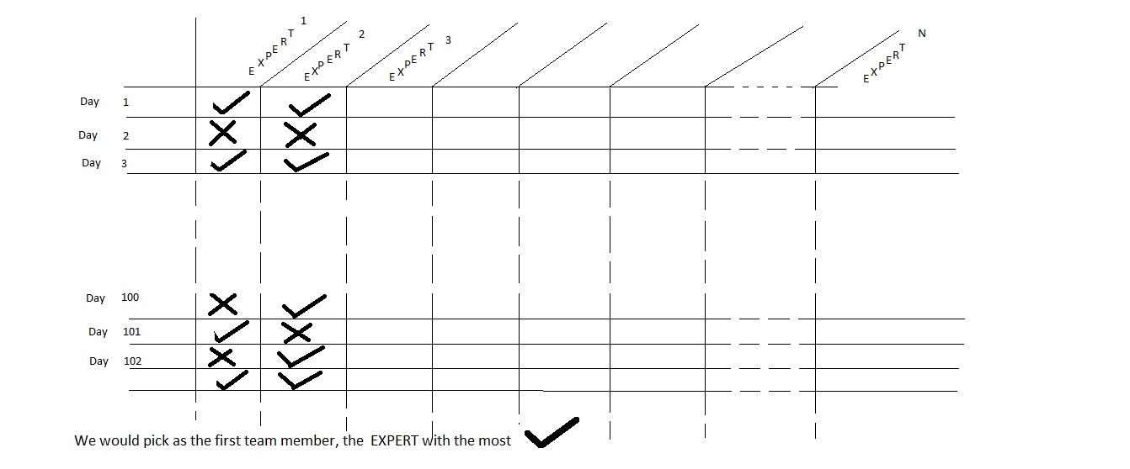
Stock Market Application: Review
So, our RP has access to a table that looks like this:

Slide 2
Picking the first member: Review
It is a correct move to pick the first member as the one with the most correct forecasts

Slide 3
Picking the second member: Review
Pick the expert who has the next highest correct score???
And that is what machine learning thinkers thought till Schapire (pronounced Sha-Pee-Ray) came along.
Schapire:
  Well, marginal gain could be small
  Marginal gain: extra benefit by the next expert
Turns out the 2nd should be the expert who gets the most correct of the examples that the 1st expert got wrong!! i.e., complements the existing team

Slide 4
Recap:
Imagine a Stock Market Application
In the investment field, many experts get paid for their stock market forecasts.
Suppose a Rich Person (RP) who would like to hire a small team of Experts.
The RP would like to have a team of size, say, 50.
The RP has access to the performance records of the 10,000 experts for the past 5 years (which is 1,000 days, since each year has 200 stock-trading days).
Now, the actual problem can be stated fully:
Once the team (of 50) is selected, its job is to look at a new day (8:30am) and
make a forecast (we will deal later with how the team functions as a team, i.e.,
how decisions will be made in a collaborative manner).
Realize that without that final task (to decide about a new day), the process
would have been a waste of time. There is a Training Stage & a Testing Stage.

Slide 5
Remark 1
Note: each expert is assumed to be a Weak Expert, named so for being correct between 51% and somewhere in the 80’s or low-90’s percent of the time. Hence we need a team of experts.
BOOSTING means picking a team of weak experts, so the team performance is strong (close to 99.9%).

Slide 6
Observations about Picking the team
Note: if an expert was worse than a Weak Expert, i.e., was correct less than 49% of the time, one would “force” it to be a weak expert by simply flipping its answers. So, if it said UP, the system would flip it to NOT-UP, and vice versa.
A “real” weak expert (e.g., correctness < 49%) could benefit the team more than the second best (e.g., correctness > 80%)!
The only time one cannot benefit from the flip is if the expert is exactly at 50%. This is very rare, and these are discarded from the pool of experts.

Slide 7
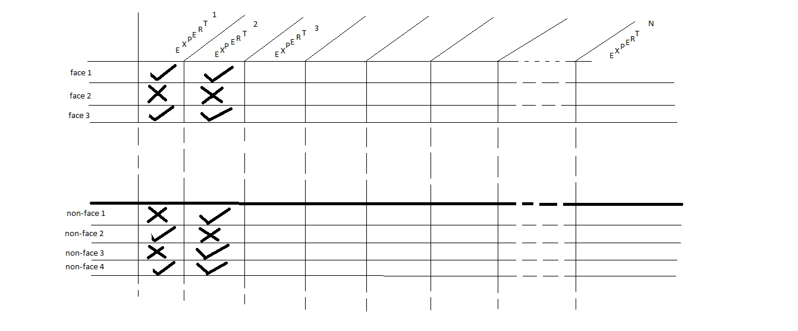
Now, do the vision problem
So, the problem can be phrased as: an expert is presented with a fixed-size
picture, and needs to say if it is a face or not.

Slide 8
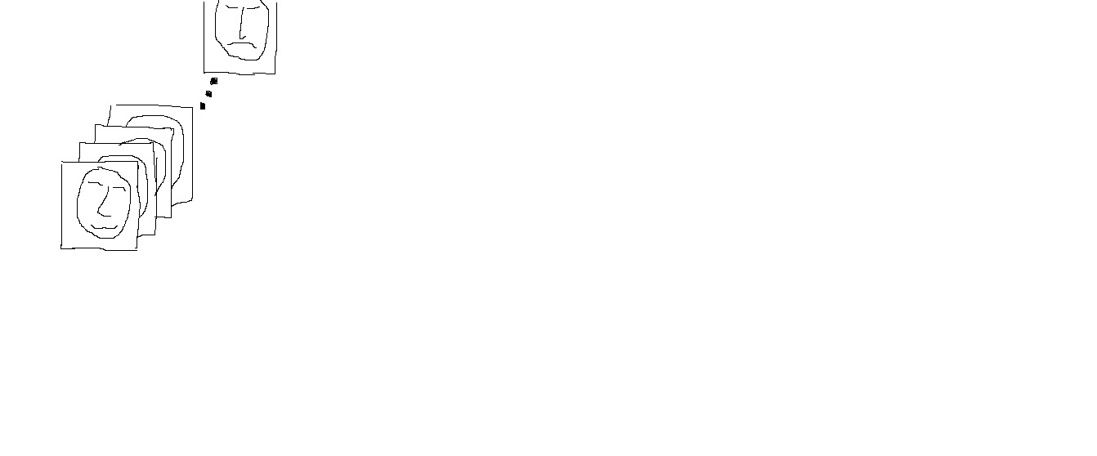
For Training Stage: Faces database

Slide 9
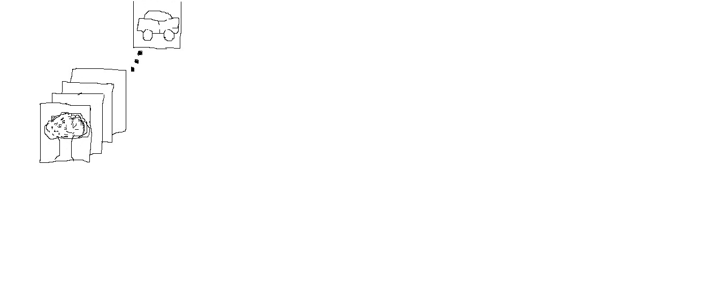
Training Stage: Non-Faces database

Slide 10
What is an expert?

Slide 11
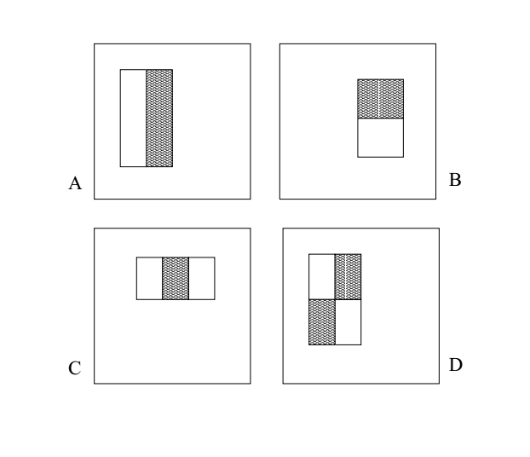
Start with a pattern from below
In the patterns above, the numbers in the region of the white bars are +1,
the black bars have numbers of -1, and the surround background numbers have 0.
The size of each pattern is the same as the size of a training image, typically something
like 50x50 pixels.

Slide 12
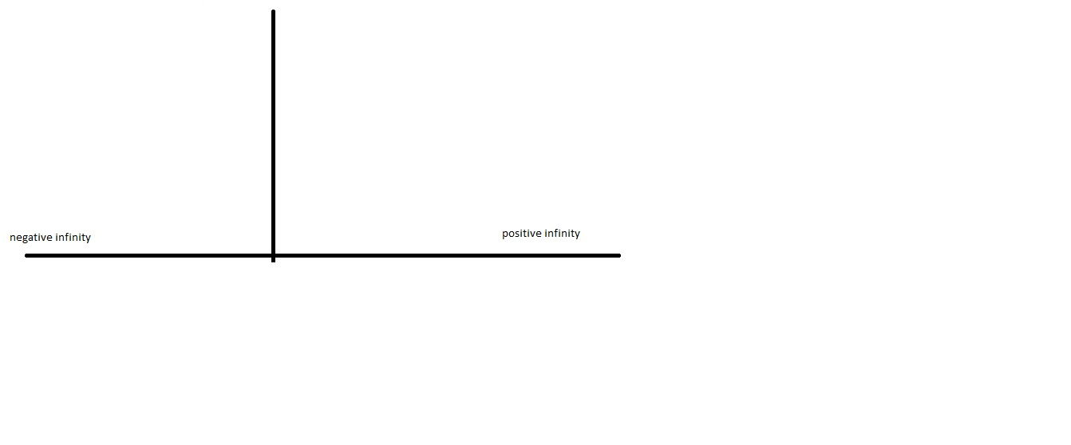
Consider the number line
In all these plots of the number-line, the depiction of the y-axis is irrelevant, and is
only included to indicate that at that position the numbers switch from negative to
positive.
0

Slide 13

Convolution of pattern with first face
Our Convolution table has a combination of 0’s, +1’s, and -1’s.
Hence, a one-step convolution between the table and our first face
is some integer between negative infinity and positive infinity.
So, plot this resulting integer on the number line.
0

Slide 14

Bring in the second face, and more

Slide 15
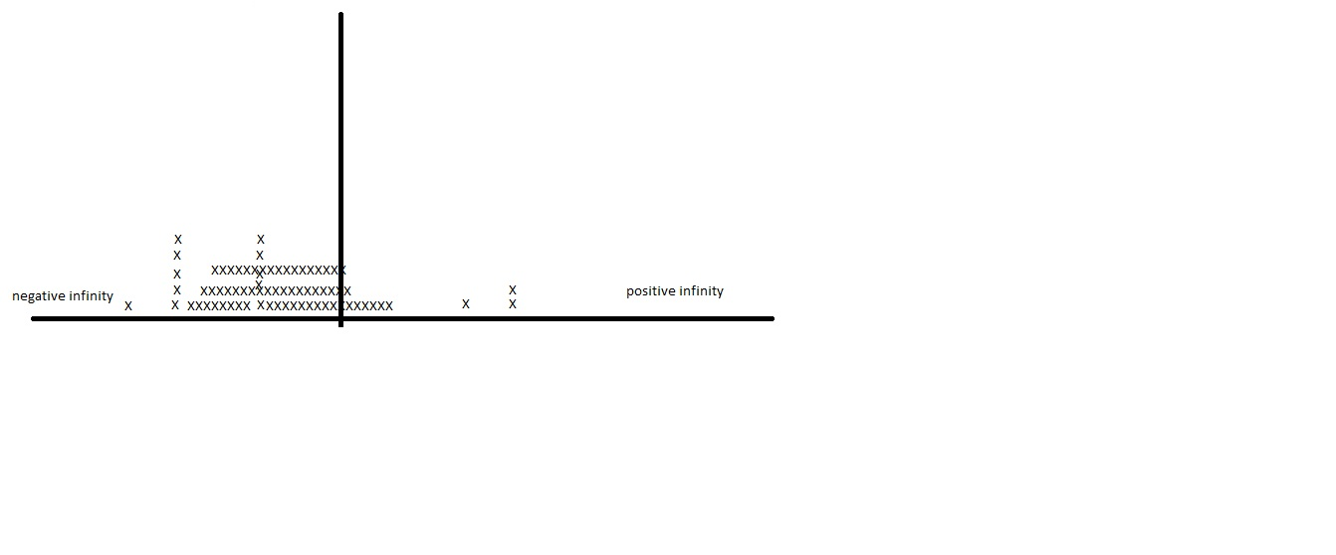
Do all faces

Slide 16
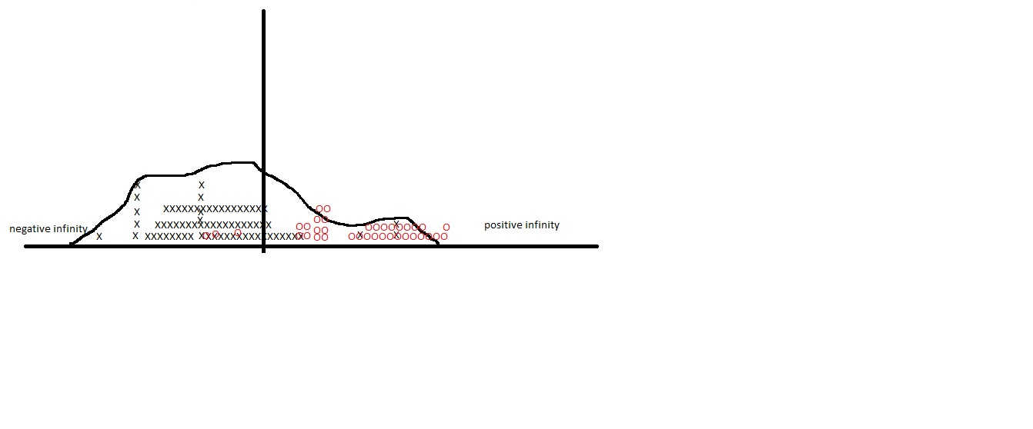
Start putting the non-faces in

Slide 17
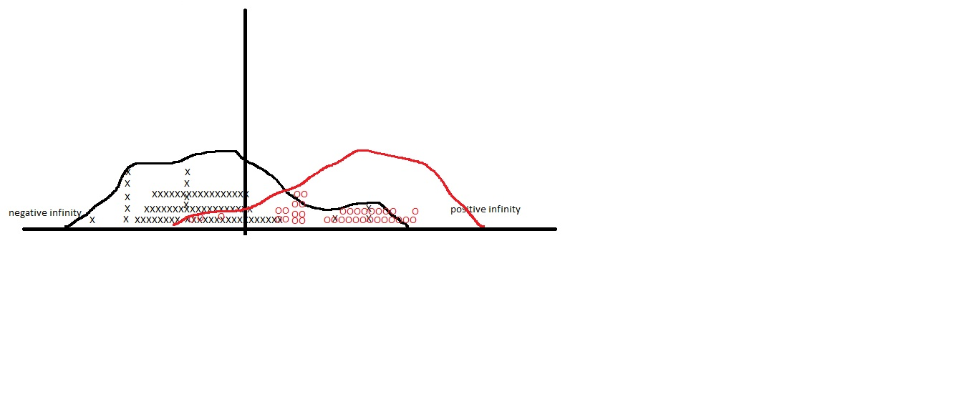
Put them both in

Slide 18
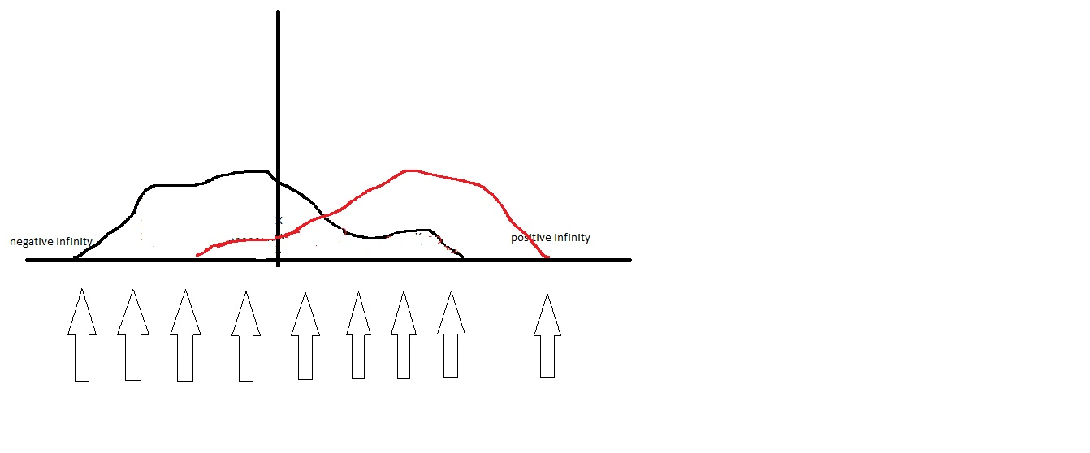
Start search for THRESHOLD
We consider a candidate Threshold (each arrow represents a possible Threshold).
For it, we then ask: Suppose we labeled its left-hand side as the realm of the negatives,
and the right hand side as the realm of the positives; then what would be the error?
i.e., given that parity-sign label, how many example actual positives end up on its left,
and how many actual negatives end up on its right, they constitute its error.

Slide 19
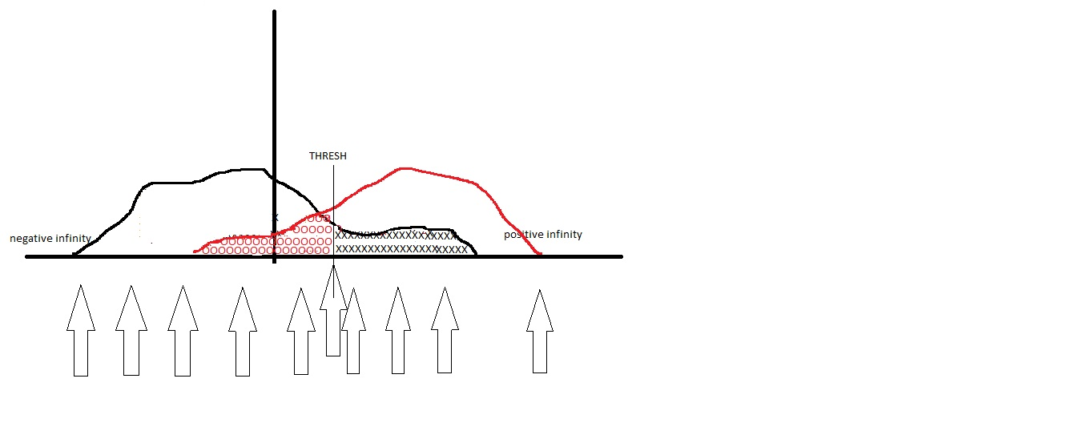
Find the best (i.e., lowest error)
Verify for yourself, that placements other than the one shown as best, would be worse.
We have shown coloring in the error for the best placement.
Now you color in the error for another choice, e.g., the arrow that is 4th from the left.

Slide 20
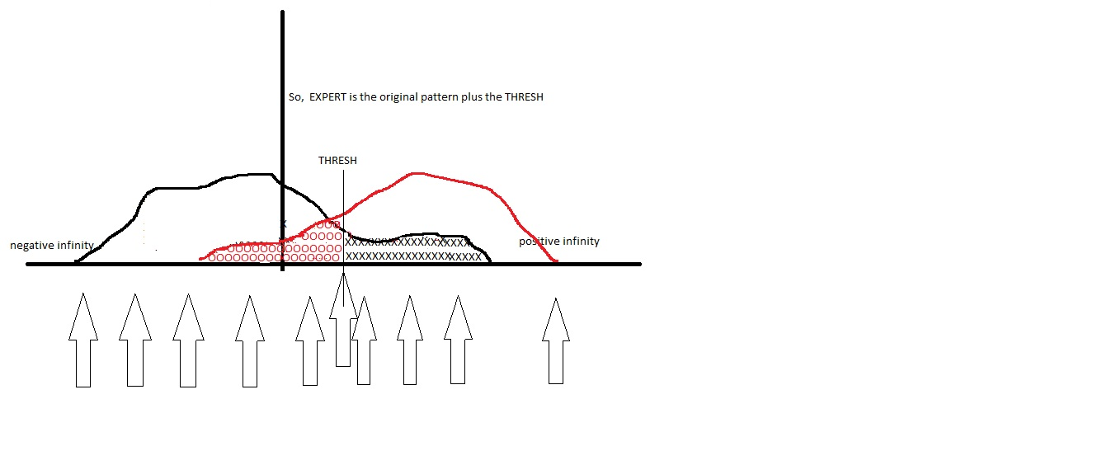
We have got one weak expert, i.e., the pattern + the threshold

Slide 21
Remember …
So, now we are able to explain how the earlier table is obtained.
i.e., once we have all our experts created (many hundreds of
thousands of them, why so many???), we see how this table can
be populated.

Slide 22
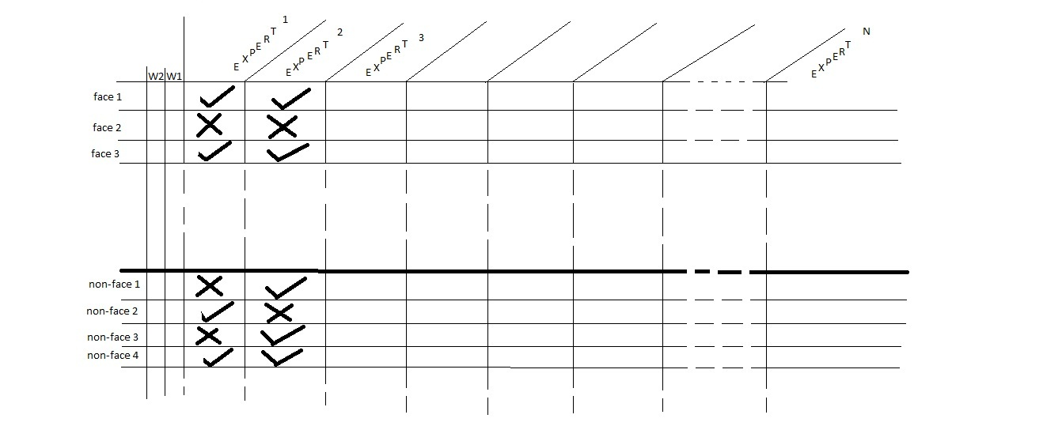
To facilitate selection, Add weights
The idea here is to not have to keep track of what experts are complementing
others and so on, and instead to have a numerical algorithm to achieve the same goals.
This is done using weights attached to each training example.
A training example is a member of our database. The weights will keep a history
of how difficult an example is to be conquered (to be classified correctly).

Slide 23
Using weights attached to examples
The basic idea is that with each selection of an expert, the weights of examples that
are not yet conquered, their weights will grow. At time to select, add every expert’s error
as the sum of the weights for the examples it has gotten wrong.
So, after many selections, say 45, if there are examples that are not yet conquered,
their weights will be quite high so they will contribute high errors to the experts who get
them wrong (which include the current team), but will contribute nothing to a fresh
expert who has not been picked so far (because it gets fewer correct). So, now, it is
its turn to be picked because it is conquering a really, really bad example (and hence
it has a lower error).

Slide 24
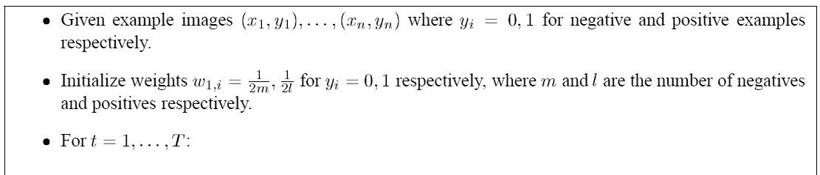
Algorithm 1
The Algorithm boxes shown in these slides are from the Viola Jones paper.
Please find the paper using Google, and refer to their algorithm shown in their box.

Slide 25
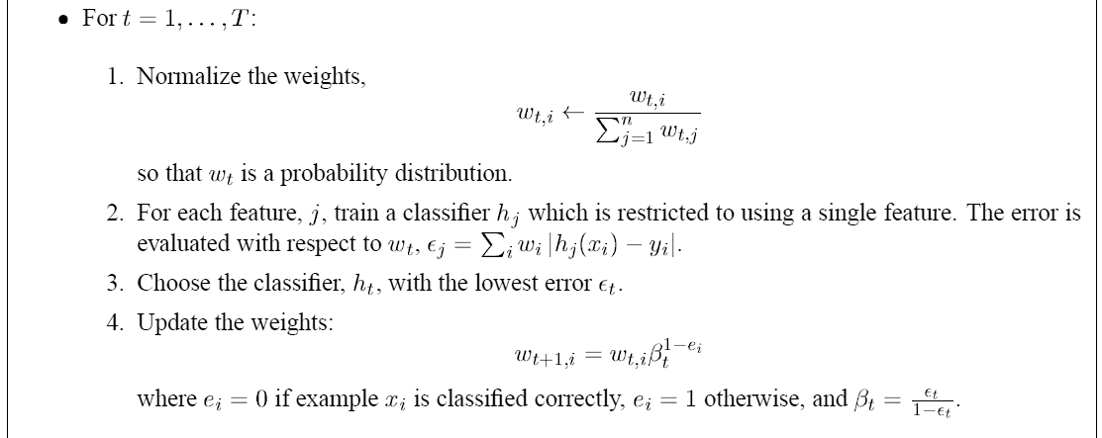
Algorithm 2

Slide 26
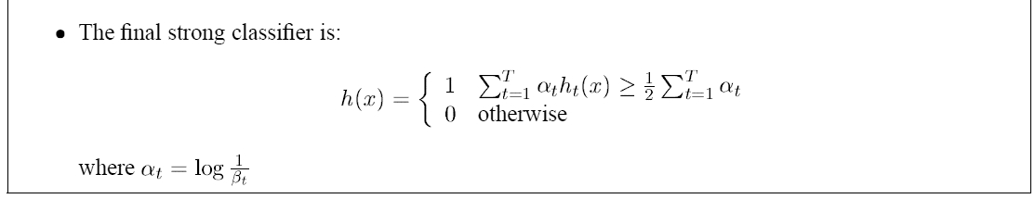
Algorithm 3

